Slide 1
Oracle Registration & Badging Guide
For alignment of certifications to Accenture and visibility in Competency Center
January 2022

Slide 2
Overview
As an Accenture practitioner, if you want to ensure Accenture has visibility over your Oracle certifications, it's important you confirm that your Oracle Partner Store account is correctly set up, by following the steps in this job aid.
Doing so will ensure Accenture is aware of your credentials, which will open the door to additional & more interesting staffing opportunities and help in performance reviews.
We highly recommend employees from Accenture's recently acquired companies spend a few minutes confirming their Oracle accounts are correctly badged.

Slide 3
Table of contents
How to register if you are a new OPN user, slides 4-7
How to affiliate to Accenture if you were registered as an OPN user with another company, slide 8
How to update your Accenture email address to your OPN account, slides 9-12
List of OPN Company IDs for Accenture, slide 14

Slide 4
How to register if you are a new OPN user
Register for access
Navigate to the Oracle Partner Store.
Sign in with your Oracle Single Sign On (SSO) account.
Select “Register for Access” to affiliate your Oracle SSO account with Accenture.

Slide 5
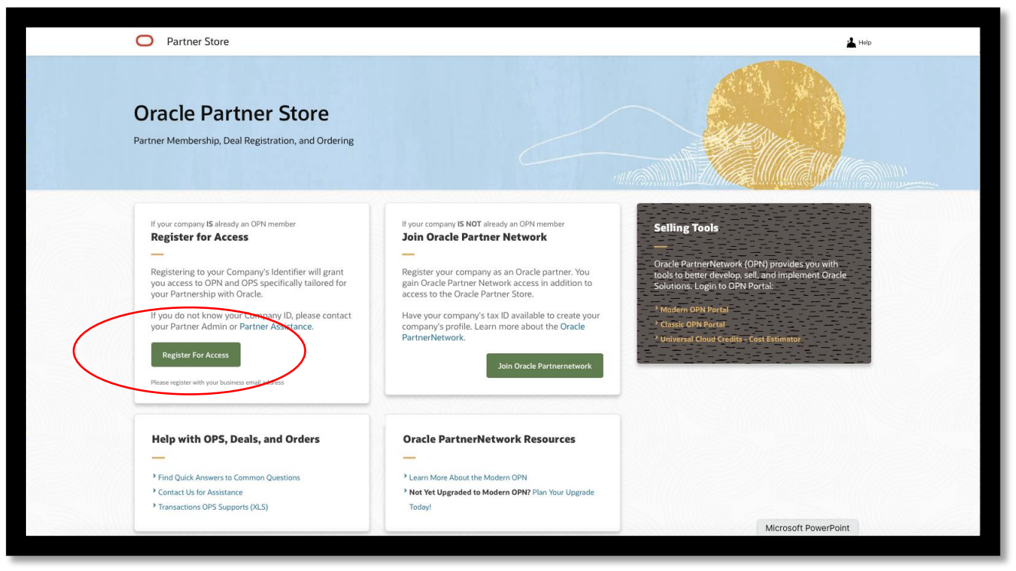
How to register if you are a new OPN user

Slide 6
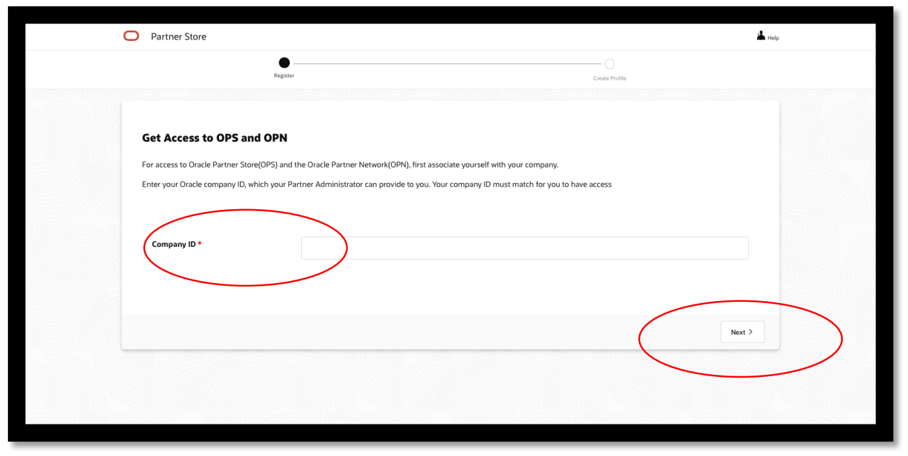
How to register if you are a new OPN user
Insert the Accenture OPN Company ID for the country you are supporting. Company IDs for Accenture can be found in slide 14 of this document.
Click “Next,” your role will be set as “Deal Registration User”, which is the default role.

Slide 7
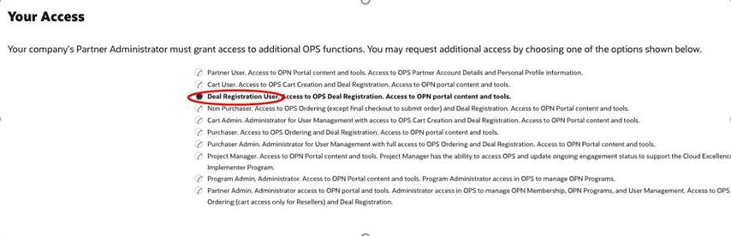
How to register if you are a new OPN user
Accept the terms and conditions. Then select the “Register” button.

Slide 8
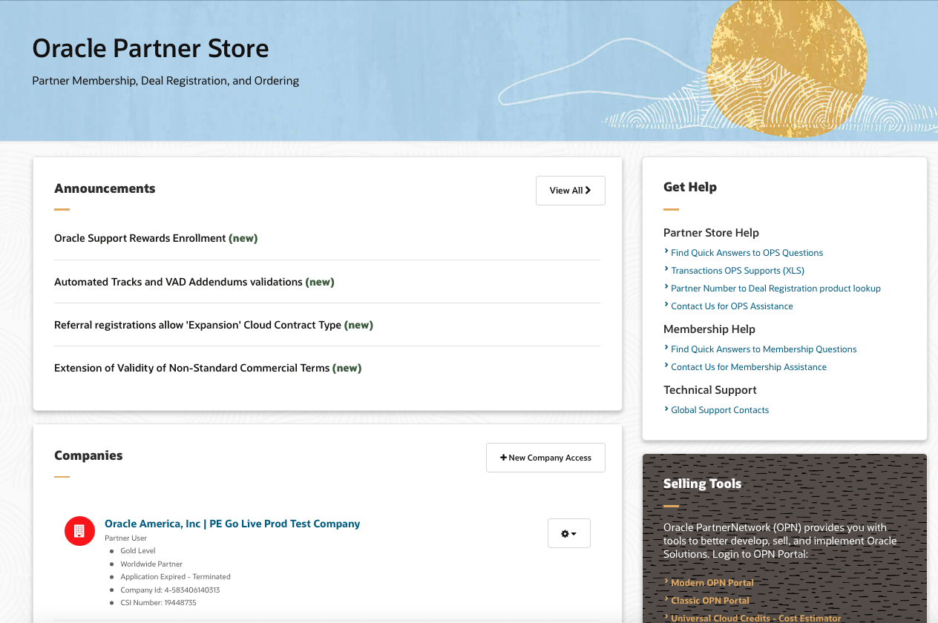
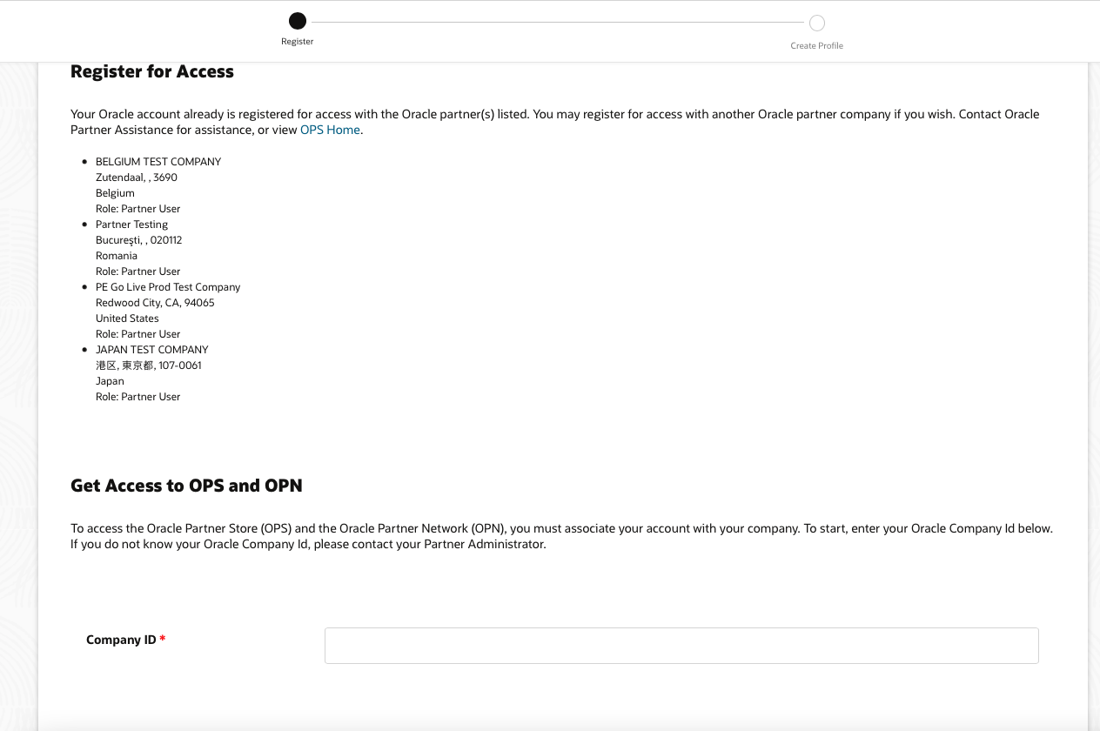
Accenture users affiliated with a previous company
Add Accenture as your current company affiliation.
Sign into to the Oracle Partner Store.
Select “+ New Company Access”.
Insert OPN Company ID for the country you are supporting. Company IDs for Accenture can be found in slide 14 of this document.
Verify that Accenture is now the company you are affiliated with, as it will be listed first on the Partner Store homepage. If Accenture is not listed first, select “Set company” to affiliate your account with Accenture’s OPN membership.

Slide 9
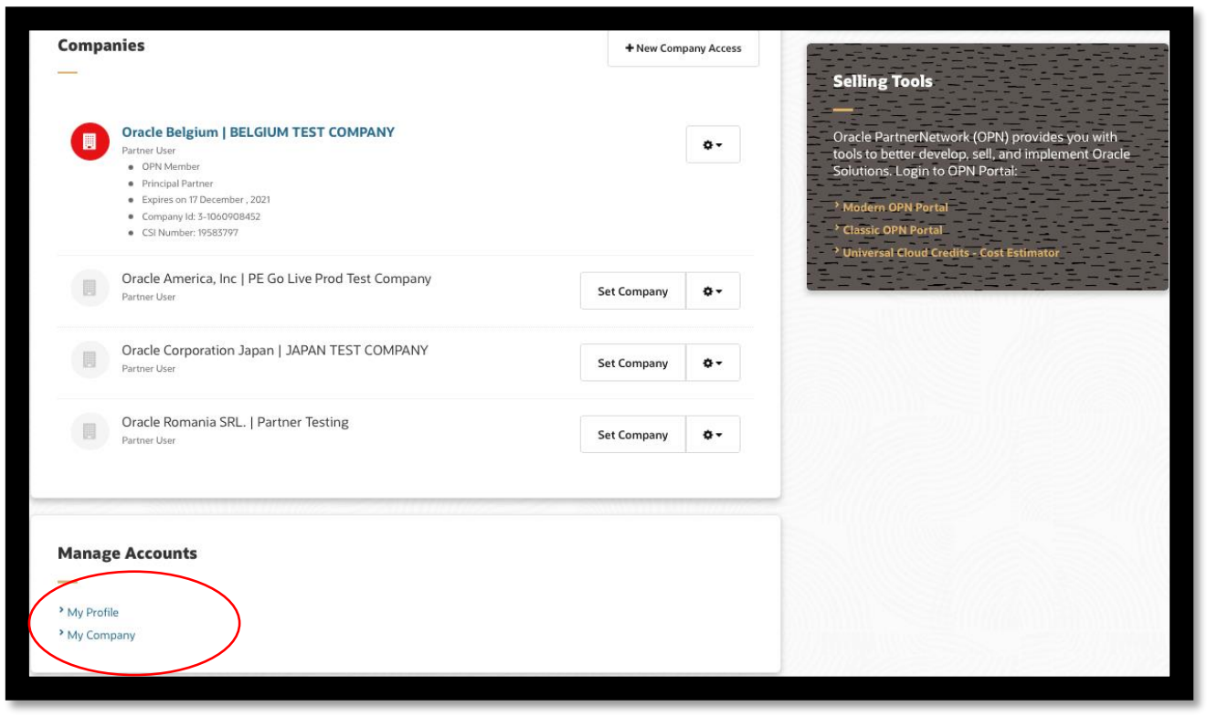
Additional instructions for users with a non-Accenture email address
If your Oracle Single Sign On (SSO) email address is not your current Accenture email address, please update it to your Accenture email address following these steps.
• Log in to the Oracle Partner Store.
• Select “My Profile” at the bottom of the screen.

Slide 10
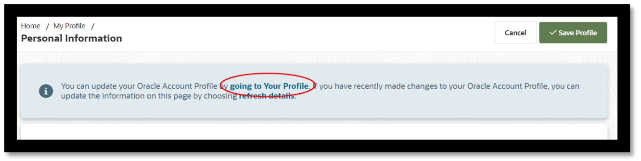
Additional instructions for users with a non-Accenture email address
Then click on “Going to your profile” as shown below.

Slide 11
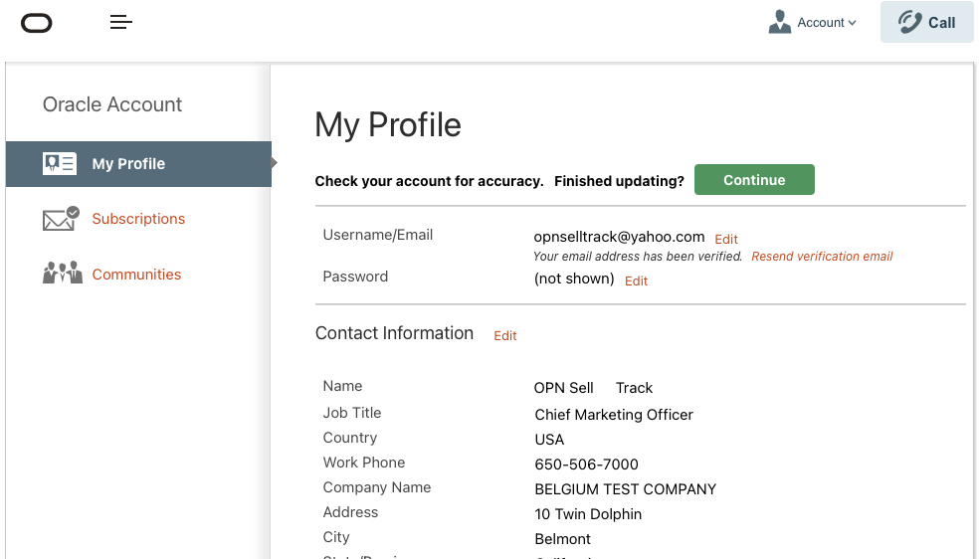
Additional instructions for users with a non-Accenture email address
Now update your email to your Accenture email address in the profile form, then select “Save and Continue”.
user@Accenture.com

Slide 12
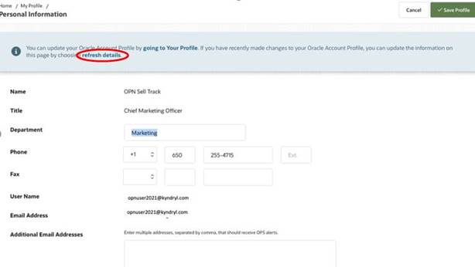
Additional instructions for users with a non-Accenture email address
• After you have changed your email ID to your Accenture email, log out.
• Then login again to the Oracle Partner Store.
• Click on the “Accounts” tab at the top of the page, scroll to “Personal information” in the drop-down list.
• Now Click on “Refresh details” in the blue bar at the top of the page.

Slide 13
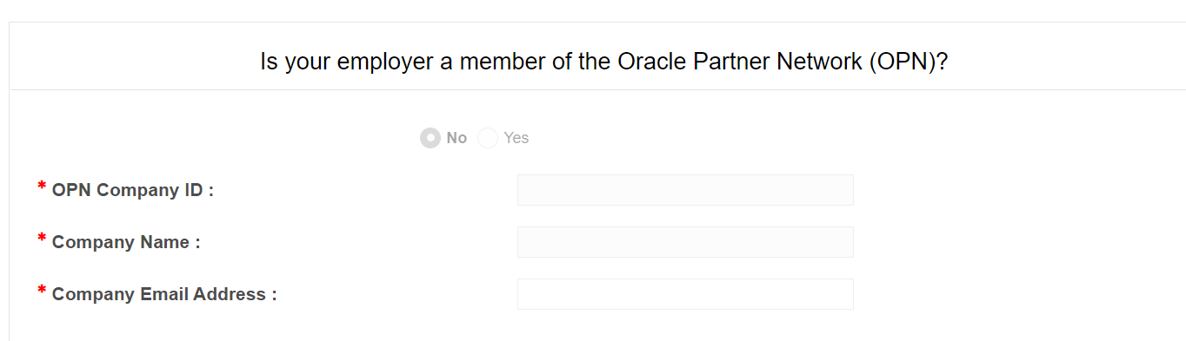
How to Update OPN ID to cert view
Login to https://certview.oracle.com
click on Login to CertView .
Sign in using oracle.com account using Accenture email id.
Select Your Profile and click edit option.
Choose yes Option in the screenshot shown below , Fill the OPN Id, Company Name and update your official Email id
Click Submit button.

Slide 14
Congratulations!
You are now registered as an Accenture user!
Important: Oracle will move your Oracle University certifications to align with your Accenture account.
This can take up to 48 hours.

Slide 15
OPN Company IDs for Accenture
Partner Country | Company Name | Company Identifier |  | Partner Country | Company Name | Company Identifier
Argentina | Accenture Service Center S.R.L. | 17328058 |  | Morocco | Accenture | 51452476
Australia | Accenture Australia Pty Ltd | 12549058 |  | Netherlands | Accenture BV | 29101379
Austria | Accenture GmbH | 12578982 |  | New Zealand | Accenture | 4-820511151219
Belgium | ACCENTURE | 20359821 |  | Nigeria | Accenture Lagos Nigeria | 41489640
Brazil | Accenture do Brasil Ltda. | 2950180 |  | Norway | Accenture AS | 12616595
Canada | Accenture Inc. | 1371661 |  | Peru | Accenture Technology Solutions Peru S.R.L. | 3-3204494901
Chile | Accenture-Chile | 27628799 |  | Philippines | Accenture Inc | 12639258
China | Accenture Technology Solutions (Dalian) Co Ltd | 13638937 |  | Poland | Accenture Services Sp.zo.o. | 11073669
Colombia | Accenture Limitada | 2945680 |  | Portugal | Accenture, Consultores de Gestao, S.A. | 31410148
Czech Republic | Accenture Central Europe B.V. Organizacni slozka | 4361542 |  | Romania | Accenture Services SRL | 42138391
Denmark | Accenture A/S | 3-5556245 |  | Russian Federation | Accenture LLC | 50346247
Finland | Accenture Oy | 6420788 |  | Saudi Arabia | Accenture Saudi Arabia Limited | 3-6701238694
France | Accenture SA | PS7834-FR |  | Singapore | Accenture Pte Ltd | 1284199
Germany | Accenture GmbH | 35999616 |  | Slovak Republic | Accenture, s.r.o. | 43507840
Ghana | Accenture Ghana Limited | 3-8007211252 |  | South Africa | Accenture South Africa (Pty) Ltd | 3-8131074373
Greece | Accenture BPM S.A. | 51394488 |  | Spain | Accenture, S.L. | 6467579
Hong Kong | Accenture | 38671406 |  | Sweden | Accenture Technology Solutions AB | 6428098
Hungary | Accenture Kft. | 36663999 |  | Switzerland | Accenture AG | 6020116
India | Accenture Services Pvt Ltd. | 4-652704171249 |  | Taiwan |  | 4392920
Indonesia | PT. Accenture | 3873486 |  | Thailand | Accenture Solutions Company Limited | 865489
Ireland | Accenture | 30137850 |  | Turkey | Accenture Danismanlik Ltd. Sti. | 18443327
Italy | Accenture SPA | 6453728 |  | United Kingdom | Accenture (UK) Limited | 6286901
Japan | Accenture Japan Ltd | 11619795 |  | USA | Accenture | 1072426
Korea | Accenture | 4542414 |  | USA-Proquire | Proquire | 13688899
Latvia | Accenture Latvijas Filiale | 13675541 |  | USA-ACN Fed Svc | Accenture Federal Services, LLC | 3-6541207862
Luxembourg | Accenture Sarl | 3-6650653112 |  | USA-AGS | Accenture Global Services Limited | 3-7374649172
Malaysia | Accenture Solutions Sdn Bhd Company | 3-5599818362 |  | Venezuela | Accenture, C.A. | 3196971
Mauritius | Accenture Mauritius Ltd | 3-1040165665 |  | Viet Nam | Cong Ty TNHH Accenture Viet Nam | 3-6466030642
Mexico | Accenture SC | 5081086

Slide 16
Thank you

